Slide 1
Copyright Notice
These slides are distributed under the Creative Commons License.
DeepLearning.AI makes these slides available for educational purposes. You may not use or distribute these slides for commercial purposes. You may make copies of these slides and use or distribute them for educational purposes as long as you cite DeepLearning.AI as the source of the slides.
For the rest of the details of the license, see https://creativecommons.org/licenses/by-sa/2.0/legalcode

Slide 2
N-Grams: Overview
deeplearning.ai

Slide 3
What you’ll be able to do!
Create language model (LM) from text corpus to
Estimate probability of word sequences
Estimate probability of a word following a sequence of words
Apply this concept to autocomplete a sentence with most likely suggestions
“chocolate“
“eggs“
“toast“
Text corpus
Language model
“Lyn is eating … “

Slide 4

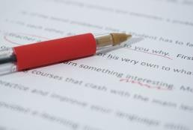

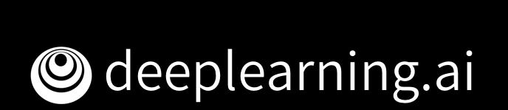
Other Applications
Speech recognition
P(I saw a van) > P(eyes awe of an)
Spelling correction
“He entered the
ship
to buy some groceries” - “ship” a dictionary word
P(entered the shop to buy) > P(entered the ship to buy)
Augmentative communication
Predict most likely word from menu for people unable to physically talk or sign.
(Newell et al., 1998)

Slide 5
Learning objectives
Process text corpus to N-gram
language model
Out of vocabulary words
Smoothing for previously unseen N-
grams
Language model evaluation
Sentence
auto-complete

Slide 6
N-grams and Probabilities
deeplearning.ai

Slide 7
Outline
What are N-grams?
N-grams and conditional probability from corpus

Slide 8
N-gram
An N-gram is a sequence of N words
Corpus: because I am learning
I | am | happy
Unigrams: {
I
, am , happy , because , learning }
Bigrams: {
I am
, am happy , happy because … }
I happy
Trigrams: { I am happy , am happy because, … }

Slide 9









Sequence notation
Corpus:
This is great
…
teacher drinks tea.

Slide 10
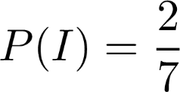
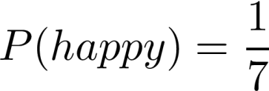
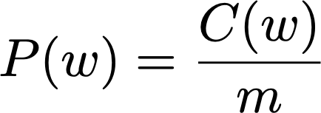
Unigram probability
Corpus:
I
am
happy
because I am learning
Size of corpus m = 7
Probability of unigram:

Slide 11

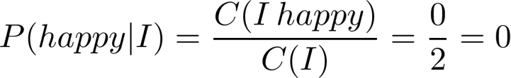
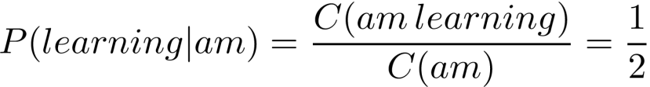
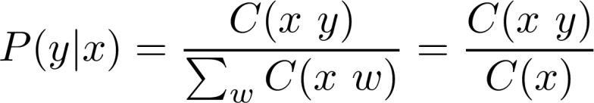
Bigram probability
Corpus: I am happy becaus
e I | am | learning
I happy
Probability of a bigram:

Slide 12
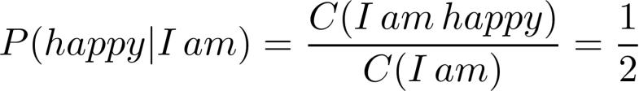
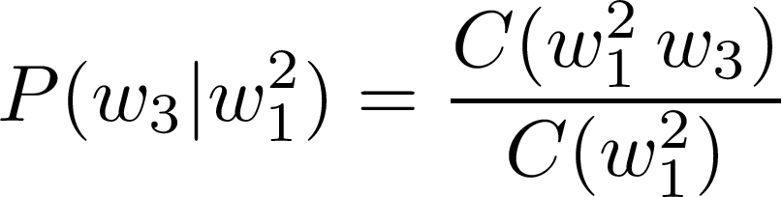
Trigram Probability
Corpus: I am happy because
I am
learning
Probability of a trigram:

Slide 13
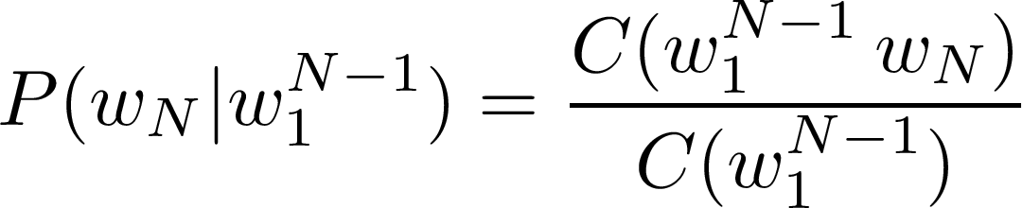


N-gram probability
Probability of N-gram:

Slide 14
Objective: Apply n-gram probability calculation on sample corpus and 3-gram.
Quiz
Question:
Corpus: “In every place of great resort the monster was the fashion. They sang of it in the cafes, ridiculed it in the papers, and represented it on the stage. ” (Jules Verne, Twenty Thousand Leagues under the Sea)
In the context of our corpus, what is the probability of word “papers” following the phrase “it in the”.
Type: Multiple Choice, single answer
Options and solution:
1. P(papers|it in the) = 0
3. P(papers|it in the) = 2/3
2.
P(papers|it in the) =1
4.
1/2
P(papers|it in the) =
= C(it in the papers)/C(it in the)

Slide 15
Sequence Probabilities
deeplearning.ai

Slide 16
Outline
Sequence probability
Sequence probability shortcomings
Approximation by N-gram probabilities

Slide 17
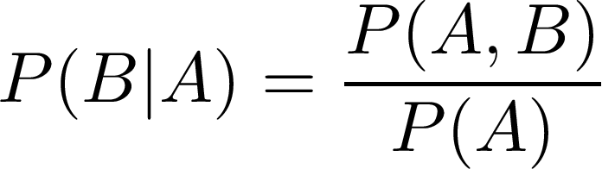

Probability of a sequence
Given a sentence, what is its probability?
?
Conditional probability and chain rule reminder

Slide 18
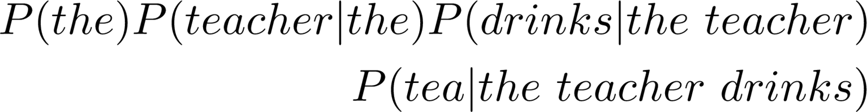
Probability of a sequence

Slide 19
Sentence not in corpus
Problem: Corpus almost never contains the exact sentence we’re
interested in or even its longer subsequences!
Input: the teacher drinks tea
Both likely 0

Slide 20



Approximation of sequence probability
the teacher drinks tea

Slide 21
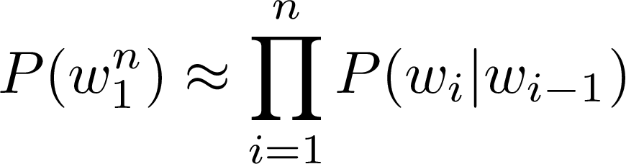
Approximation of sequence probability
Markov assumption: only last N words matter
Bigram
N-gram
Entire sentence modeled with bigram

Slide 22
Quiz
Objective: Apply sequence probability approximation with bigrams.
Question:
Given these conditional probabilities
P(Mary)=0.1;
P(Mary|likes) =0.2;
P(likes)=0.2; P(likes|Mary) =0.3;
P(cats)=0.3
P(cats|likes)=0.1; P(likes|cats)=0.4
Approximate the probability of the following sentence with bigrams: “Mary likes cats”
Type: Multiple Choice, single answer
Options and solution:
1. P(Mary likes cats) = 0
2.
P(Mary likes cats) =1
3. P(Mary likes cats) = 0.003
4.
P(Mary likes cats) = 0.008

Slide 23
Starting and Ending Sentences
deeplearning.ai

Slide 24
Outline
Start of sentence symbols <s>
End of sentence symbol </s>

Slide 25
Start of sentence token <s>
the
teacher drinks tea
<s> the
teacher drinks tea

Slide 26
Start of sentence token <s> for N-grams
Trigram:
the teacher drinks tea => <s> <s> the teacher drinks tea
N-gram model: add N-1 start tokens <s>

Slide 27
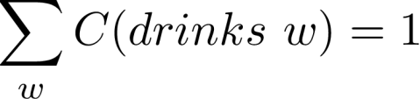

End of sentence token </s> - motivation
Corpus:
<s> Lyn
<s> John
drinks |  | chocolate
 | drinks

Slide 28







End of sentence token </s> - motivation
Corpus
<s> yes no
<s> yes yes
<s> no no
Sentences of length 2:
<s> yes yes
<s> yes no
<s> no no
<s> no yes

Slide 29




End of sentence token </s> - motivation
Corpus
<s> yes no
<s> yes yes
<s> no no
Sentences of length 2:
<s> yes yes
<s> yes no
<s> no no
<s> no yes

Slide 30




End of sentence token </s> - motivation
Sentences of length 3:
<s> yes yes yes
<s> yes yes no
…
<s> no no no
Corpus
<s> yes no
<s> yes yes
<s> no no

Slide 31
End of sentence token </s> - motivation
Corpus
<s> yes no
<s> yes yes
<s> no no

Slide 32
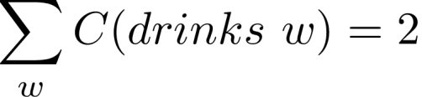
End of sentence token </s> - solution
Bigram
<s> the teacher drinks tea =>
<s> the teacher drinks tea </s>
Corpus:
<s> Lyn drinks chocolate
<s> John drinks </s>
</s>

Slide 33
End of sentence token </s> for N-grams
N-gram => just one </s>
E.g. Trigram:
the teacher drinks tea => <s> <s> the teacher drinks tea </s>

Slide 34
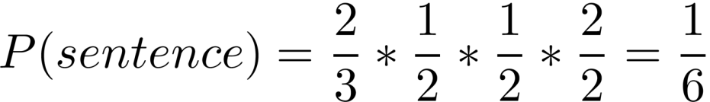
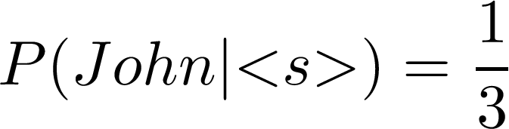
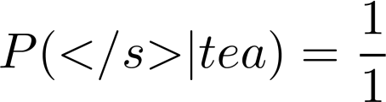
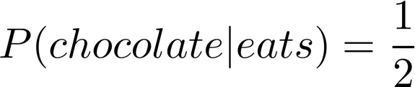


Example - bigram
Corpus
<s> John drinks tea </s>
<s> Lyn eats chocolate </s>
<s> | Lyn | drinks | chocolate | </s>

Slide 35
Quiz
Objective: Apply sequence probability approximation with bigrams after adding start and end word.
Question:
Given these conditional probabilities
P(Mary)=0.1;
P(Mary|<s>)=0.2;
P(likes|Mary) =0.3;
P(likes)=0.2; P(</s>|cats)=0.6 P(cats|likes)=0.1
P(cats)=0.3
Approximate the probability of the following sentence with bigrams: “<s> Mary likes cats </s>”
Type: Multiple Choice, single answer
Options and solution:
2. P(<s> Mary likes cats </s>) =0.0036
1. P(<s> Mary likes cats </s>) = 0
3. P(<s> Mary likes cats </s>) = 0.003
4. P(<s> Mary likes cats </s>) = 1

Slide 36
The N-gram Language Model
deeplearning.ai

Slide 37
Outline
Count matrix
Probability matrix
Language model
Log probability to avoid underflow
Generative language model

Slide 38
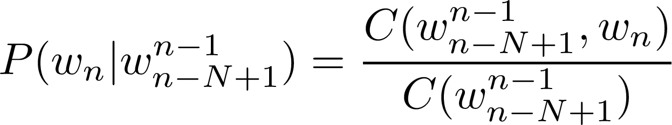
Count matrix
Rows: unique corpus (N-1)-grams
Columns: unique corpus words
Corpus: <s>I study I learn</s>
Bigram
count matrix
 | <s> | </s> | I | study | learn
<s> | 0 | 0 | 1 | 0 | 0
</s> | 0 | 0 | 0 | 0 | 0
I | 0 | 0 | 0 | 1 | 1
study | 0 | 0 | 1 | 0 | 0
learn | 0 | 1 | 0 | 0 | 0
“study I” bigram

Slide 39

Probability matrix
Divide each cell by its row sum
Corpus: <s>I study I learn</s> Count matrix (bigram)
Probability matrix
 | <s> | </s> | I | study | learn | sum
<s> | 0 | 0 | 1 | 0 | 0 | 1
</s> | 0 | 0 | 0 | 0 | 0 | 0
I | 0 | 0 | 0 | 1 | 1 | 2
study | 0 | 0 | 1 | 0 | 0 | 1
learn | 0 | 1 | 0 | 0 | 0 | 1
 | <s> | </s> | I | study | learn
<s> | 0 | 0 | 1 | 0 | 0
</s> | 0 | 0 | 0 | 0 | 0
I | 0 | 0 | 0 | 0.5 | 0.5
study | 0 | 0 | 1 | 0 | 0
learn | 0 | 1 | 0 | 0 | 0

Slide 40
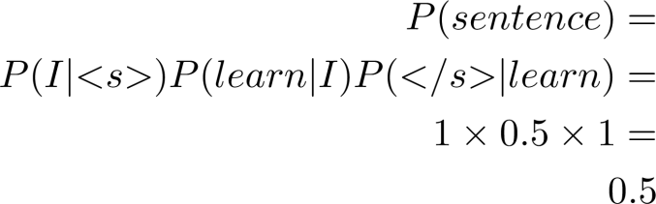
Language model
probability matrix => language model
Sentence probability
Next word prediction
 | <s> | </s> | I | study | learn
<s> | 0 | 0 | 1 | 0 | 0
</s> | 0 | 0 | 0 | 0 | 0
I | 0 | 0 | 0 | 0.5 | 0.5
study | 0 | 0 | 1 | 0 | 0
learn | 0 | 1 | 0 | 0 | 0
Sentence probability:
<s> I learn </s>

Slide 41
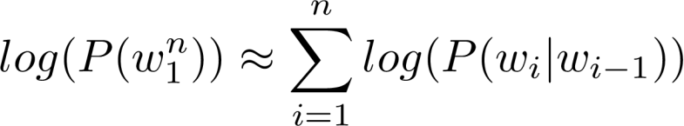
Log probability
All probabilities in calculation <=1 and multiplying them brings risk
of underflow
Logarithm properties reminder
Use log of the probabilities in Probability matrix and calculations
Converts back from log

Slide 42
Generative Language model
Corpus:
<s> Lyn drinks chocolate </s>
<s> John drinks tea </s>
<s> Lyn eats chocolate </s>
1.
(<s>, Lyn)
or (<s>, John)?
2. (Lyn,eats) or
(Lyn,drinks)
?
3.
4.
(drinks,tea)
or (drinks,chocolate)?
(tea,</s>)
- always
Algorithm:
Choose sentence start
Choose next bigram starting with previous word
Continue until </s> is picked

Slide 43
Quiz
Objective: Apply sum when calculating log probability instead of product.
Question:
Given the logarithm of these conditional probabilities:
log(P(Mary|<s>))=-2; log(P(</s>|cats))=-1 log(P(likes|Mary)) =-10; log(P(cats|likes))=-100
Approximate the log probability of the following sentence with bigrams : “<s> Mary likes cats </s>”
Type: Multiple Choice, single answer
Options and solution:
1. log(P(<s> Mary likes cats </s>)) = -113
2.
log(P(<s> Mary likes cats </s>)) =2000
3. log(P(<s> Mary likes cats </s>)) = 113
4.
log(P(<s> Mary likes cats </s>))= -112

Slide 44
Language Model Evaluation
deeplearning.ai

Slide 45
Outline
Train/Validation/Test split
Perplexity

Slide 46
Test data
Split corpus to Train/Validation/Test
Evaluate on Training dataset
For smaller corpora
80% Train
10% Validation
10% Test
For large corpora (typical for text)
98% Train
1% Validation
1% Test

Slide 47
Test data - split method
Continuous text
Random short sequences
Test
Validation
Training
Corpus

Slide 48


Perplexity
W → test set containing m sentences s
* i-th sentence in the test set, each ending with </s>
m → number of all words in entire test set W including
</s> but not including <s>

Slide 49
Perplexity
E.g. m=100
Smaller perplexity = better model
Character level models PP < word-based models PP

Slide 50
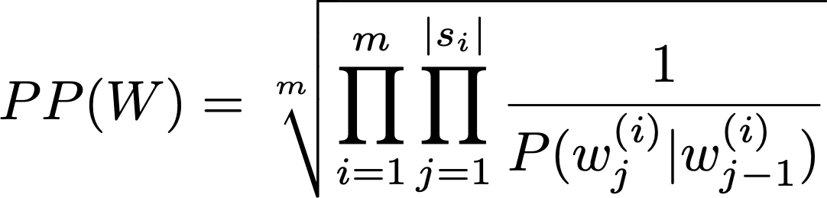

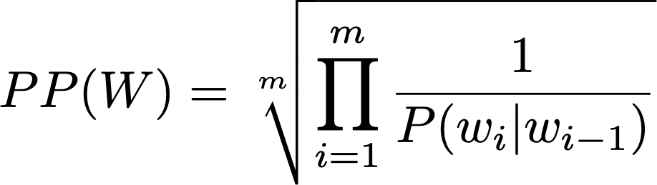

Perplexity for bigram models
* j-th word in i-th sentence
concatenate all sentences in W
* i-th word in test set

Slide 51
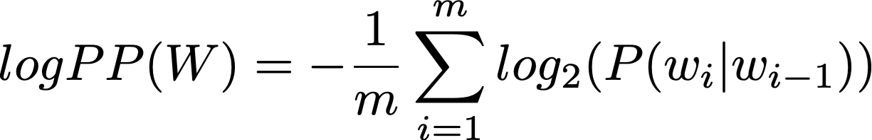
Log perplexity

Slide 52
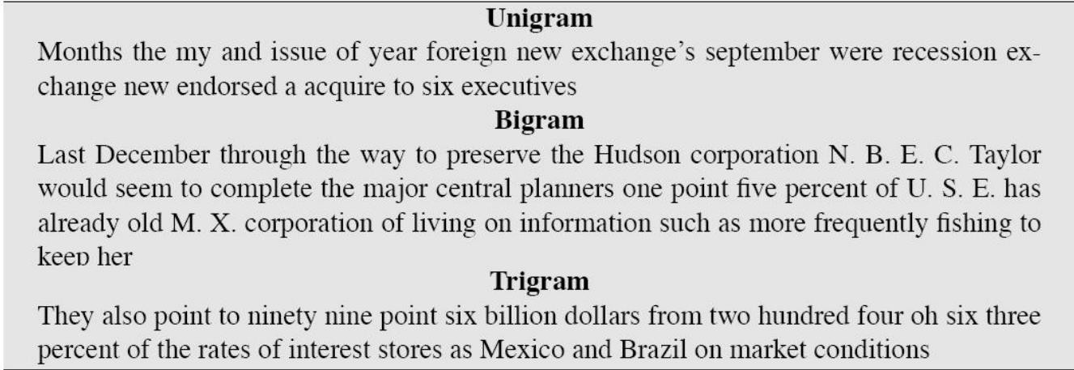
Examples
Training 38 million words, test 1.5 million words, WSJ corpus
Perplexity Unigram: 962 Bigram: 170 Trigram: 109
[Figure from Speech and Language Processing by Dan Jurafsky et. al]

Slide 53
Quiz
Objective: Calculate log perplexity from log probabilities using sum and correct normalization coefficient (not including <s>).
Question:
Given the logarithm of these conditional probabilities: log(P(Mary|<s>))=-2; log(P(</s>|cats))=-1 log(P(likes|Mary)) =-10; log(P(cats|likes))=-100
Assuming our test set is W=“<s> Mary likes cats </s>”, what is the model’s perplexity.
Type: Multiple Choice, single answer
Options and solution:
1. log PP(W) = -113
3. log PP(W) = (-1/5)*(-113)
2. log PP(W) = (-1/4)*(-113)
4. log PP(W) = (-1/5)*113

Slide 54
Out of Vocabulary Words
deeplearning.ai

Slide 55
Outline
Unknown words
Update corpus with <UNK>
Choosing vocabulary

Slide 56
Out of vocabulary words
Closed vs. Open vocabularies
Unknown word = Out of vocabulary word (OOV)
special tag <UNK> in corpus and in input

Slide 57
Using <UNK> in corpus
Create vocabulary V
Replace any word in corpus and not in V by <UNK>
Count the probabilities with <UNK> as with any other word

Slide 58
Example
Corpus
<s> Lyn drinks chocolate </s>
<s> John drinks tea </s>
<s> Lyn eats chocolate </s>
Corpus
<s> Lyn drinks chocolate </s>
<s> <UNK> drinks <UNK> </s>
<s> Lyn <UNK> chocolate </s>
Min frequency f=2
Input query
Vocabulary
Lyn, drinks, chocolate
<s>Adam drinks chocolate</s>
<s><UNK> drinks chocolate</s>

Slide 59
How to create vocabulary V
Criteria:
Min word frequency f
Max |V|, include words by frequency
Use <UNK> sparingly
Perplexity - only compare LMs with the same V

Slide 60
Quiz
Objective: Create corpus vocabulary based on minimum frequency.
Question:
Given the training corpus and minimum word frequency=2, how would the vocabulary for corpus preprocessed with <UNK> look like?
“<s> I am happy I am learning </s> <s> I am happy I can study </s>”
Type: Multiple Choice, single answer
Options and solution:
1. V = (I,am,happy)
2.
V = (I,am,happy,learning,can,study)
3. V = (I,am,happy,I,am)
4.
V =
(I,am,happy,learning,can,study,<UNK>)

Slide 61
Smoothing
deeplearning.ai

Slide 62
Outline
Missing N-grams in corpus
Smoothing
Backoff and interpolation

Slide 63
Missing N-grams in training corpus
Problem: N-grams made of known words still might be missing in
the training corpus
“John” , “eats” in corpus “John eats”
Their counts cannot be used for probability estimation
Can be 0

Slide 64
Smoothing
Advanced methods: Kneser-Ney smoothing Good-Turing smoothing
Add-one smoothing (Laplacian smoothing)
Add-k smoothing

Slide 65
Backoff
If N-gram missing => use (N-1)-gram, …
Probability discounting e.g. Katz backoff
“Stupid” backoff
Corpus
<s> Lyn drinks chocolate </s>
<s> John drinks tea </s>
<s> Lyn eats chocolate </s>

Slide 66
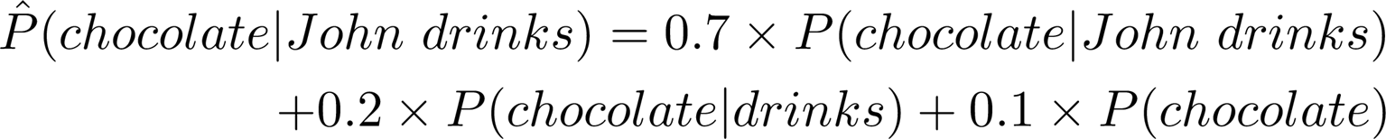
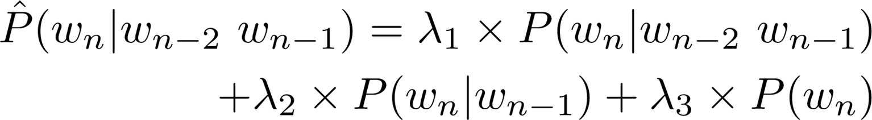
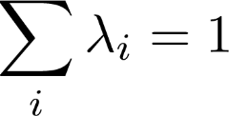
Interpolation

Slide 67
Quiz
Objective: Apply n-gram probability with add-k smoothing for phrase not present in the corpus.
Question:
Corpus: “I am happy I am learning”
In the context of our corpus, what is the estimated probability of word “can” following the word “I” using the
bigram model and add-k-smoothing where k=3.
Type: Multiple Choice, single answer
Options and solution:
1. P(can|I) = 0
2.
P(can|I) =1
3. P(can|I) = 3/(2+3*4)
4.
P(can|I) = 3/(3*4)

Slide 68
Week Summary
deeplearning.ai

Slide 69
Summary
N-Grams and probabilities
Approximate sentence probability from N-Grams
Build language model from corpus
Fix missing information
Out of vocabulary words with <UNK>
Missing N-Gram in corpus with smoothing, backoff and interpolation
Evaluate language model with perplexity
Coding assignment!

